Slide 1
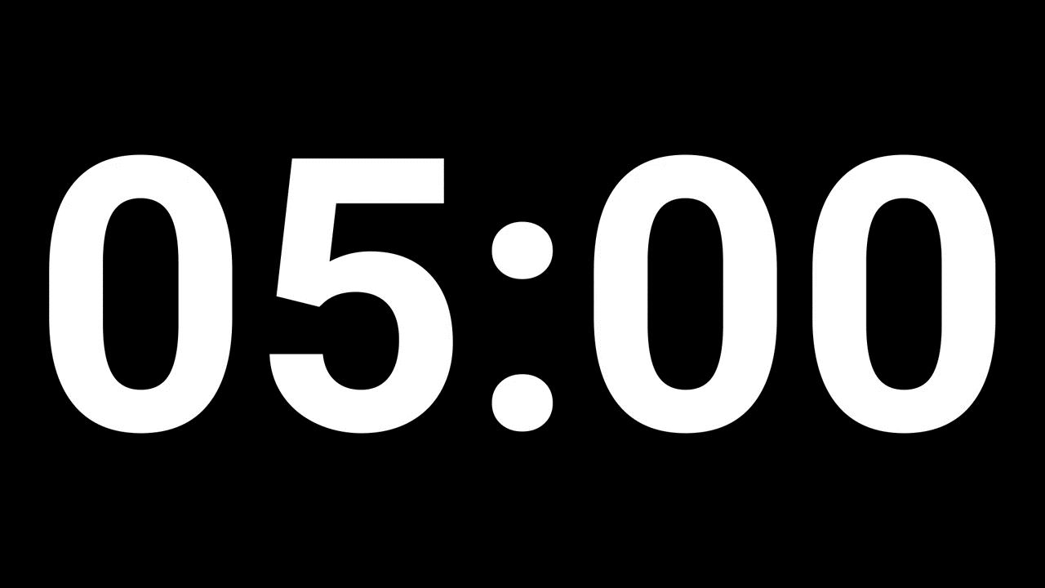
Q. A box contains 20 electric bulbs, out of which 4 are defective. Two bulbs are chosen at random from this box. The probability that at least one of these is defective is?
4/19
7/19
12/19
21/95
Correct Answer: B

Slide 2
Q. 48, 23, ?, 4.25, 1.125
10.5
10
2.5
11
Correct Answer: A

Slide 3
Q. Find the total number of employee code that can be formed by using two alphabets followed by 2 numbers and the letters should be distinct.
61000
54000
65000
63000
Correct Answer: C

Slide 4
Q. 4, 6, 15, ?, 201, 1011, 6073
49
64
81
144
Correct Answer: A

Slide 5
Q. A train crosses a platform 100 m long in 60 seconds at a speed of 45 kmph. The time taken by the train to cross an electric pole is?
8 sec
52 sec
1 min
45 sec
Correct Answer: B

Slide 6
Q. A can build up a wall in 8 days while B can break it in 3 days. A has worked for 4 days and then B joined to work with A for another 2 days only. In how many days will A alone build up the remaining part of the wall?
19/3
7
22/3
40/3
Correct Answer: C

Slide 7
Q. A is thrice as good a workman as B and so takes 60 days less than B for doing a job. The time in which they can do the job together is?
45/2
30
45
60
Correct Answer: A

Slide 8
Q. Sweets were distributed equally among 64 children. After giving 7 sweets to each child, 15 sweets were left out. Total how many sweets were there?
436
446
448
463
Correct Answer: D

Slide 9
Q. A person on tour has Rs.360 for his daily expenses. If he extends his tour for 4 days, he has to cut his daily expenses by Rs.3. Find the original duration of the tour.
15 days
24 days
20 days
30 days
Correct Answer: C

Slide 10
Q. A train passes a platform 90 m long in 30 seconds and a man standing on the platform in 15 seconds. The speed of the train is?
12.4 KMPH
14.6 KMPH
18.4 KMPH
21.6 KMPH
Correct Answer: D

Slide 11
Q. A box contains 2 white balls, 3 black balls and 4 red balls. In how many ways can 3 balls be drawn from the box, if at least one black ball is to be included in the draw?
32
48
64
96
Correct Answer: C

Slide 12
Q. If GO = 32, SHE = 49, then SOME will be equal to?
56
58
62
64
Correct Answer: A

Slide 13
Q. Odd man out: 3, 7, 15, 27, 63, 127, 255
27
7
15
127
Correct Answer: A

Slide 14
Q. A bag contains 6 black, 5 white and 8 yellow balls. If four balls are picked at random, what is the probability that all four of them are either black or any two out of the four are white?
3/1292
925/3876
359/1927
23/24
Correct Answer: B

Slide 15
Q. If FULFNHW is the code for CRICKET, then EULGH is the code for which word?
PRIDE
BRIDE
BLADE
BLIND
Correct Answer: B

Slide 16
Q. In a class, 30% of the students offered English, 20% offered Hindi and 10% offered both. If a student is selected at random, what is the probability that he has offered English or Hindi?
2/5
3/4
3/5
3/10
Correct Answer: A

Slide 17
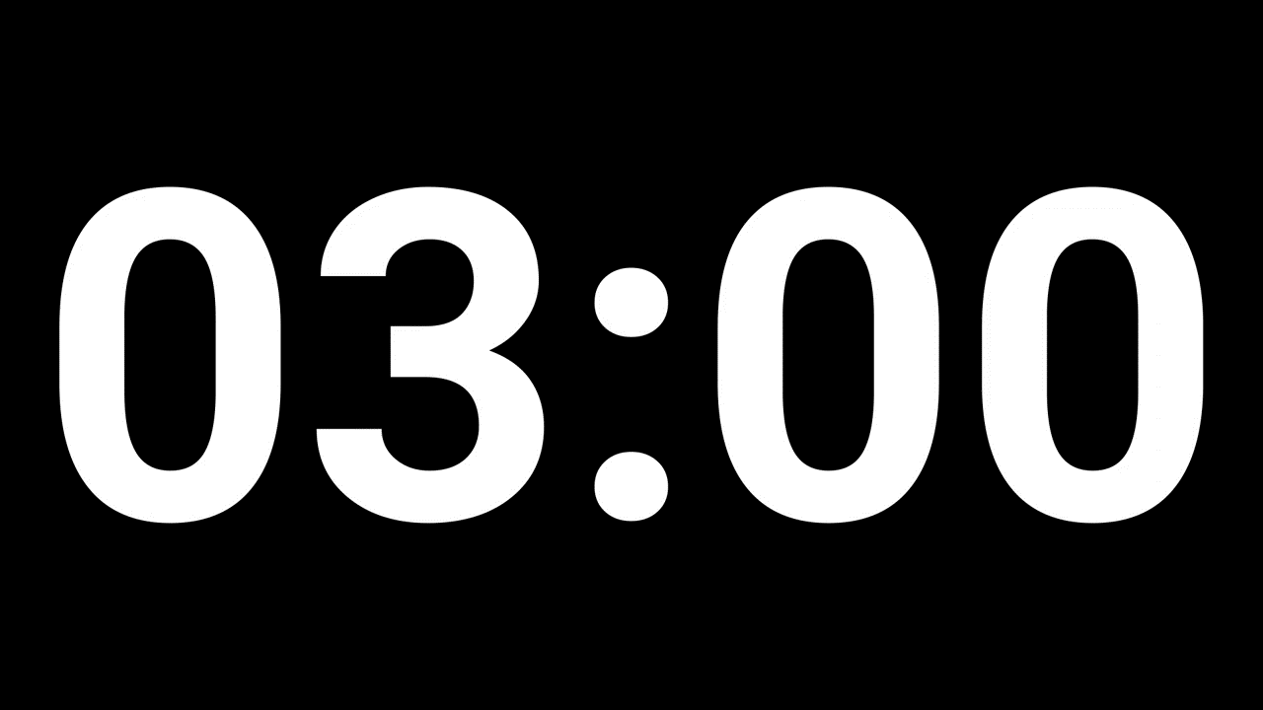
Q. A, B and C can do a piece of work in 20, 30, and 60 days respectively. In how many days can A do the work if he is assisted by B and C on every third day?
12
15
16
18
Correct Answer: B

Slide 18
Q. In a certain code, SIKKIM is written as THLJJL. How is TRAINING written in that code?
SQBHOHO
UQBHOHO
UQBJOHHO
UQBJHOFO
Correct Answer: B

Slide 19
Q. A can complete a piece of work in 10 days, B in 15 days and C in 20 days. A and C worked together for 2 days and then A was replaced by B. In how many days, altogether, was the work completed?
6
8
10
12
Correct Answer: B

Slide 20
Q. 1 man or 2 women or 3 boys can do a work in 44 days. Then in how many days will 1 man, 1 woman and 1 boy do the work?
24
48
36
40
Correct Answer: A

Slide 21
Q. Two trains are running in opposite directions with the same speed. If the length of each train is 120m and they crosse each other in 12 seconds, then the speed of each train is?
10
18
36
72
Correct Answer: C

Slide 22
Q. A sum of Rs. 1360 has been divided among A, B and C such that A gets 2/3 of what B gets and B gets 1/4 of what C gets. B's share is:
120
160
240
300
Correct Answer: C

Slide 23
Q. Two trains 200 m and 150 m long are running on parallel tracks in the same direction at speeds of 40 kmph and 45 kmph respectively. Time taken by the faster train to cross the slowed train?
72 s
132 s
192 s
252 s
Correct Answer: D

Slide 24
Q. In a certain code, FORCE is written as FPTJI. How is CULPRIT written in that code?
CSJNPGR
CSJNPGR
CVNSVNZ
CXOSULW
Correct Answer: C

Slide 25
Q. 74 is divided into two parts so that 5 times one part and 11 times the other part are together equal to 454. The parts are?
14, 60
60, 14
30, 44
44, 30
Correct Answer: B

Slide 26
Q. 1, 2, 8, 33, 148, 765, ?
4626
3654
2454
3764
Correct Answer: A

Slide 27
Q. There are 5 professors, 8 lecturers and 7 teachers. Six people to be selected to make an interview board. In how many ways can they selected if it contains equal number of professors, lecturers and teachers?
5880
4770
3450
2180
Correct Answer: A

Slide 28
Q. Train A crosses a stationary train B in 50 seconds and a pole in 20 seconds with the same speed. The length of the train A is 240 m. What is the length of the train B?
260 m
300 m
360 m
400 m
Correct Answer: C

Slide 29
Q. In a box, there are 8 red, 7 blue and 6 green balls. One ball is picked up randomly. What is the probability that it is neither red nor green?
2/3
3/4
7/19
8/21
Correct Answer: D

Slide 30
Q. The total number of committees of 7 people is to be formed from 9 boys and 6 girls such that the boys are in the majority and it has at least 1 girl.
4914
2072
2076
3426
Correct Answer: A

Slide 31
Q. Odd man out: 3, 8, 18, 46, 100, 210, 432
8
18
46
100
Correct Answer: B

Slide 32
Q. An urn contains 4 green, 5 blue, 2 red and 3 yellow marbles. If eight marbles are drawn at random, what is the probability that there are equal number of marbles of each color?
4/7
361/728
60/1001
1
Correct Answer: C

Slide 33

Q. Two dice are tossed. The probability that the total score is a prime number is?
1/6
5/12
1/2
7/9
Correct Answer: B

Slide 34
Q. A and B can do a piece of work in 5 days, B and C can do it in 7 days, A and C can do it in 4 days. Who among these will take the least time if put to do it alone?
A
B
C
Data inadequate
Correct Answer: A

Slide 35
Q. Find the number of different words that can be formed from the word ‘SUCCESS’.
360
480
420
5040
Correct Answer: C

Slide 36
Q. Cost of 8 pens and 4 pencils is Rs.176 and the cost of 2 pens and 2 pencils is Rs.48. What is the cost of one pen?
20
16
18
14
Correct Answer: A

Slide 37
Q. A train, 240 m long, crosses a man walking along the line in opposite direction at the rate of 3 kmph in 10 seconds. The speed of the train is?
63
75
83.4
86.4
Correct Answer: C

Slide 38
Q. Kim can do a work in 3 days while David can do the same work in 2 days. Both of them finish the work together and get Rs.150. What is the share of Kim?
30
60
70
75
Correct Answer: B

Slide 39
Q. In a family, the father took 1/4 of the cake and he had 3 times as much as each of the other members had. The total number of family members is?
3
7
10
12
Correct Answer: C

Slide 40
Q. A 180 m long train crosses another 270 m long train running opposite direction in 10.8 s. If the speed of the first train is 60 kmph, what is the speed of the second train in kmph?
80
90
150
120
Correct Answer: B

Slide 41
Q. 1/4 of a tank holds 135 liters of water. What part of the tank is full if it contains 180 liters of water?
1/6
1/3
2/3
2/5
Correct Answer: B

Slide 42
Q. A committee of 5 persons is to be formed from 6 men and 4 women. In how many ways can this be done when at most 2 women are included?
124
132
186
174
Correct Answer: C

Slide 43
Q. In a code language, ‘mok dan sil’ means ‘nice big house’; ‘fit kon dan’ means ‘house is good’ and ‘warm tir fit’ means ‘cost is high’. Which word stands for ‘good’ in that language?
mok
dan
fit
kon
Correct Answer: A

Slide 44
Q. 40960, 10240, 2560, 640, ?, 40, 10
200
320
160
120
Correct Answer: C

Slide 45
Q. If BELIEF is written as afkkdi, how is SELDOM written in that code?
tfkenp
rfkfnp
rfkenn
rdkcnl
Correct Answer: B

Slide 46
Q. If PAINT is coded as 74128 and EXCEL is coded as 93596, then how would you encode ACCEPT?
455978
547978
554978
735961
Correct Answer: A

Slide 47
Q.1 Two cards are drawn from a pack of 52 cards. The probability that either both are red or both are kings, is?
7/13
3/26
63/221
55/221
Correct Answer: D

Slide 48
Q. 10, 5, 13, 10, 16, 20, 19, ?
22
40
38
23
Correct Answer: B

Slide 49
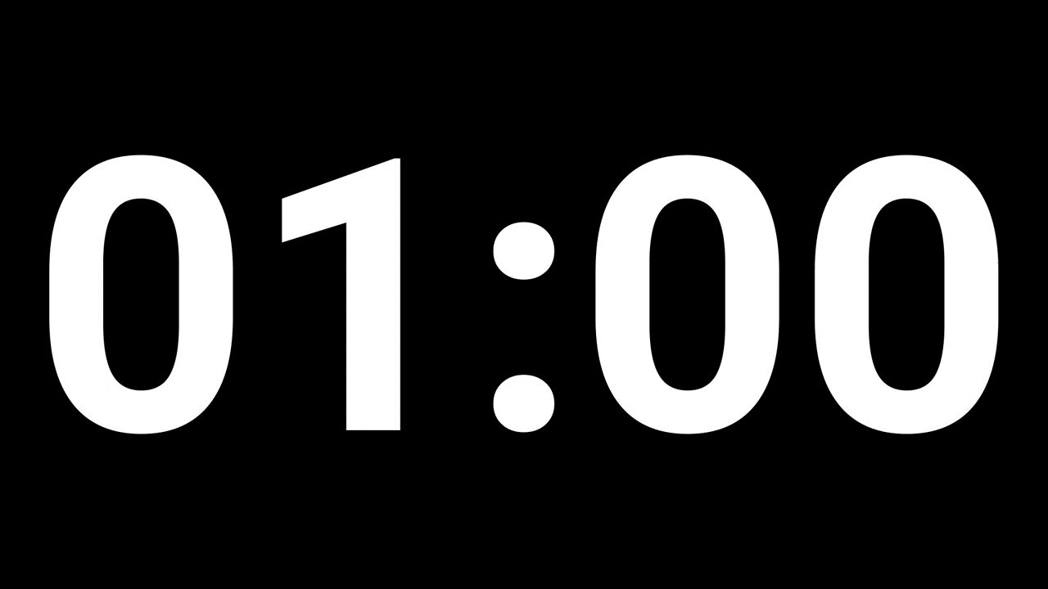
Q. Two dice are tossed. The probability that the total score is an odd number?
1/6
5/12
1/2
7/9
Correct Answer: C

Slide 50
Q. Two-fifth of one-fourth of three-seventh of a number is 15. What is half of that number?
175
94
188
96
Correct Answer: A

Slide 51
Q. A man can do a piece of work in 5 days, but with the help of his son, he can do the same work in 3 days. In what time can the son do it alone?
13/2
7
15/2
8
Correct Answer: C

Slide 52
Q. If 8 men, working 9 hours per day can build a wall 18 meters long, 2 meters wide and 12 meters high in 10 days. How many men will be required to build a wall 32 meters long, 3 meters wide and 9 meters high by working 6 hours a day in 8 days?
25
18
30
16
Correct Answer: C

Slide 53
Q. Rahul and Saif appear for an interview for two vacancies. The probability of Rahul’s selection is 1/3 and that of Saif’s selection is 1/5. Find the probability that at least one of them is selected.
1/15
8/15
8/9
7/15
Correct Answer: D

Slide 54
Q. 1, 8, 27, 64, 125, 216, ?
354
392
343
245
Correct Answer: C

Slide 55
Q. In how many ways the letters of the word ‘WOMEN’ can be rearranged so that when consonant occupies odd places, vowel comes on even places?
10
11
12
13
Correct Answer: C

Slide 56
Q. The sum of weights of A and B is 80 kgs. Half of the weight of A is equal to 5/6 times the weight of B. Find the weight of B.
20
30
40
60
Correct Answer: B

Slide 57
Q. How many words can be made of letters COURTESY which began with C and end with Y?
120
540
420
720
Correct Answer: D

Slide 58
Q. A train takes 9 s to cross a pole, if the speed of train is 48 kmph, then the length of train is?
150
120
90
80
Correct Answer: B

Slide 59
Q. Rahul and Saif appear for an interview for two vacancies. The probability of Rahul’s selection is 1/3 and that of Saif’s selection is 1/5. Find the probability that both of them will be selected.
1/15
8/15
8/9
7/8
Correct Answer: A

Slide 60
Q. The length of the bridge, which a train 130 meters long and travelling at 45 kmph can cross in 30 seconds is?
200
225
245
250
Correct Answer: C

Slide 61
Q. How many 3-digit numbers can be formed from the digits 2, 3, 5, 6, 7, and 9, which are divisible by 5 and none of the digits is repeated?
5
10
15
20
Correct Answer: D

Slide 62
Q. 9, 11, 15, 23, 39, ?
56
64
42
71
Correct Answer: C

Slide 63
Q. If sky is called sea, sea is called water, water is called air, air is called cloud and cloud is called river, then what do we drink when thirsty?
sky
air
water
sea
Correct Answer: B

Slide 64
Q. If CONTRIBUTE is written as ETBUIRNTOC, which letter will be in the sixth place when counted from the left if POPULARISE is written in that code?
L
A
I
R
Correct Answer: A

